Slide 1
New Metrics for New Media
Web 2.0 Expo New York City
October 10 2011

Slide 2
What we’re going to do today
Overview of the session
Strategy & measurement
New media imperative
Review scorecard templates/metrics for 6 different scenarios >break in the middle<
  Brand example
  Scorecard & metrics
  Tool demo
Organizing for Social Media
Q & A

Slide 3
Logistics
Hashtags: #socialmeasure #w2e
People: @setlinger, @blake, @margaretfrancis
Survey: http://surveymonkey
References: SlideShare, GoogleDocs, Contact Info
Link to Altimeter Report:
  http://j.mp/altimetersocialframework2011

Slide 4
Who We Are
Margaret Francis / @margaretfrancis
  Current Chief Product Officer at stealth mode startup
  Former VP Product Scout Labs/ Lithium Technologies, former agency strategist at Razorfish
Susan Etlinger / @setlinger
  Industry Analyst with Altimeter Group
  Former SVP at PR firm Horn Group, 20 years agency/ inhouse marketing and communications
Blake Robinson / @blake
  Data and analytics consultant
  Former Director, Technology & Research at Attention and Analyst in Residence at Webtrends
  Writings in TechCrunch, Read/Write Web and Mashable
Notes:
No service bias. Converseon, Undercurrent, Attention, Edelman

Slide 5












Brands We Know

Slide 6
The (Not So) Dirty Little Secret
“There is no single ROI for social media.”
- Richard Binhammer, Strategic Corporate Communications, Social Media. and Corporate Reputation Management, Dell Inc.,

Slide 7
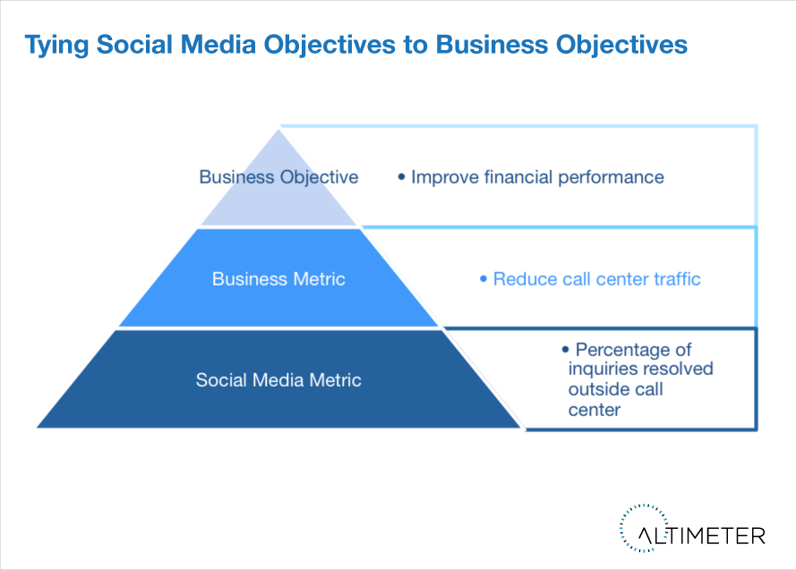
Tying Social Media to the Business

Slide 8
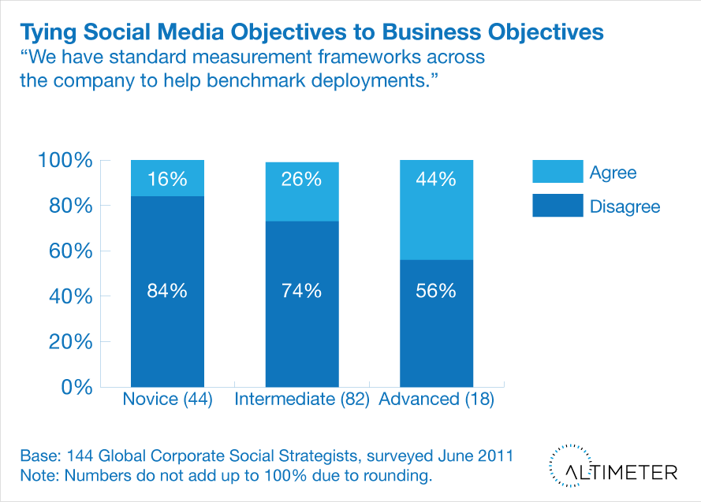
Few Know How to Measure

Slide 9
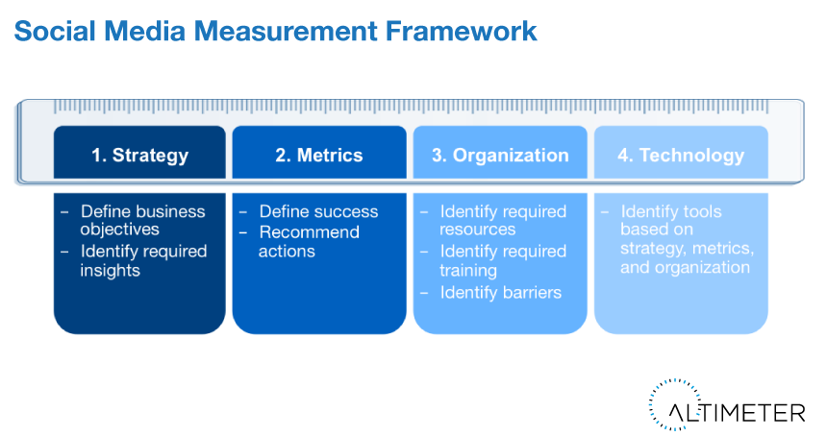
A Measurement Framework

Slide 10
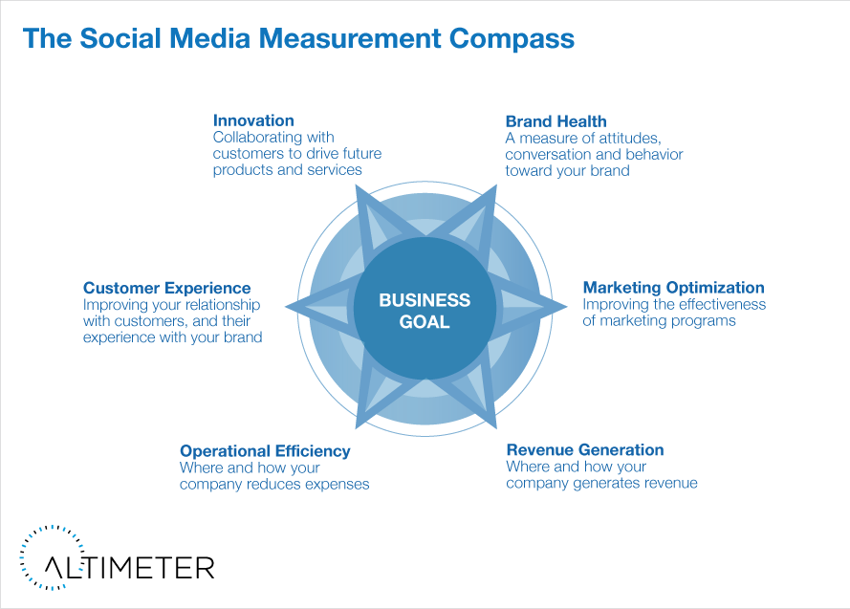
The Use Cases for New Media

Slide 11

Media & Measurement, 1990
TV
Print
OOH
Sale!
Radio
WOM
Mail
Warranty Card
Telephone Survey
Credit/ Payment Info
Focus groups

Slide 12
We get digital

Slide 13
Measurement, 2000
Online Ads
Clicks
Page Views
Sessions
Register
Optin
Search
TV
Print
Sale!
OOH
Radio
WOM
Warranty Card
Mail
Telephone Survey
Credit/ Payment Info
Focus groups

Slide 14
We get social

Slide 15
Measurement, 2011
Blog
Digg
Post
Review Product
Share
Make video
Post
Review
Like
Fan
Re-Tweet
Book mark
Tweet
Rate
Online Ads
Clicks
Page Views
Sessions
Register
Optin
Search
Sale!
TV
Print
Warranty Card
OOH
Credit/ Payment Info
Telephone Survey
Radio
WOM
Focus groups
Social Media

Slide 16
The more digital our communications get, the more transactions we perform online, the higher our expectations of what we can measure

Slide 17
So what can we measure?

Slide 18
SOME “SOCIAL” METRICS
# Video Views % YouTube Favorites % YouTube channel subscribers % YouTube Video Plays # of YouTube Channel Comments # of YouTube video reviews # slideshare views # delicious bookmarks # diggs # of Blog Mentions # of Forum mentions # of Facebook mentions # of Twitter mentions # @mentions # of reviews mentions # of comments Positive : Negative Mentions for any channel # Twitter followers Twitter Follower-Rate # reviews # stars in reviews Thread size Unique contributors Unique commenters | # Facebook fan pages # Facebook fans Facebook Fan Rate Facebook Likes Email Open Rate Email Click Rate Email Forward rate Email opt-out rate # of Email subscribers # of SMS subscribers Clicks/ CTR Impressions Traffic Reach Registration Opt-in Page views Visit/session length (% site visits > 60 secs) Click path analysis Eye tracking studies #/% Downloads Changes in SERP results/ rankings Earned/ Owned traffic Inbound links

Slide 19

Three Kinds of Marketing Metrics
ACTIVITIES
CONSUMER RESPONSE
BUSINESS OUTCOMES
Videos posted
Tweets responded to
Online media served
Changes in perception (NPS, Intent to purchase, customer satisfaction)
Consumer engagements (Like, Click, Download)
Submission of information (email, lead form, shopping preferences)
Revenue
Cost Savings
Better ROI
Higher market share

Slide 20
On being in love with perfect data
"All models are wrong; some models are useful”
George Box, Statistician

Slide 21
New Media Use Cases
Brand Health (including PR/ Reputation Management)
Marketing Optimization
Revenue Generation
Customer Experience
Operational Efficiency
Innovation

Slide 22
Brand Health
A measure of attitudes, conversation and behavior toward your brand

Slide 24
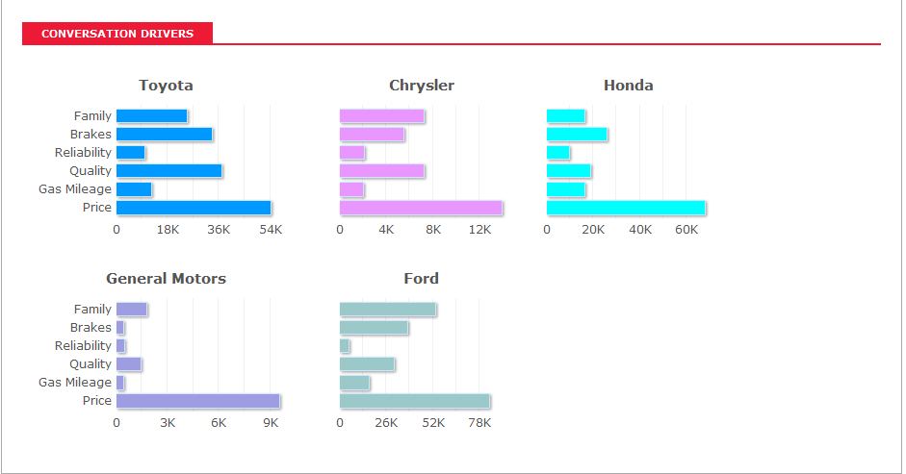
Brand Health
Metric:
Share of conversation on a specific topic
Used with permission of Netbase

Slide 25
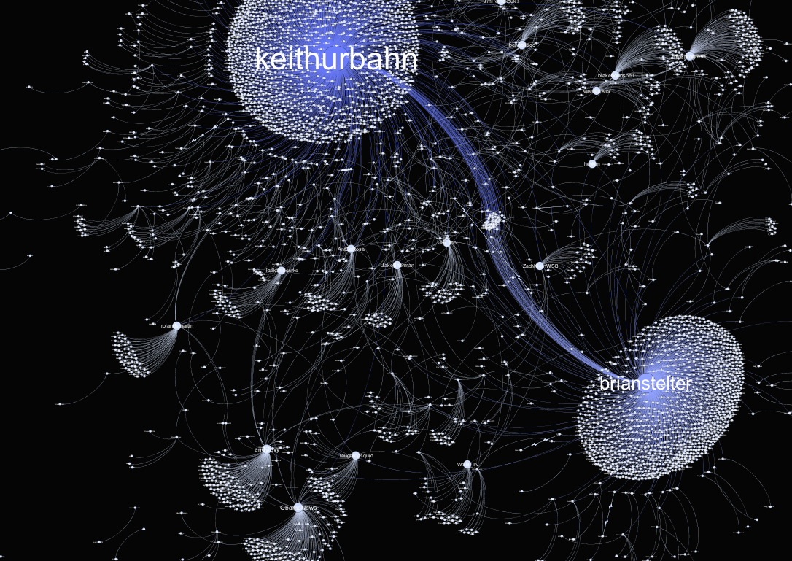
A look at Influence
Source: SocialFlow

Slide 26
Brand Health Scorecard
METRIC | PURPOSE | OLD MEDIA METRIC/ DATA SOURCE | NEW MEDIA METRICS | NEW MEDIA DATA SOURCE
BRAND PREFERENCE | Do consumer prefer our brand to competitive brands? | Share of Voice | Share of Conversation | SMM tools
BRAND PERCEPTION | Do consumers associate the desired brand attributes with the brand? | Market Research | Theme/Cluster Analysis | SMM tools, Wordle
BRAND BUZZ | Do we have more mindshare than our competitors with our target market? | Market Research | Buzz vs competitors | SMM tools
AUDIENCE ANALYTICS | Are the segments engaging with the brand the ones we are targeting? | Customer database | Facebook Insights | Facebook, Customer DB, Twitter
BUZZ (PR/ Reputation Management) | Are we igniting relevant conversations with our outreach activities? | PR Services | Buzz timeline, annotated | SMM tools, annotation
SENTIMENT (PR/ Reputation Mgmnt) | Are they having the right impact? | Market Research | Sentiment Analysis of SM | SMM tools, custom analysis
INFLUENCE (PR/ Reputation Mgmnt) | Are the right people talking about the brand? | PR Services | SM Influencer Scorecarding | Twitter, Klout, Kred
CUSTOMER IMPACT SURVEYS | Have our communications changed consumer opinion? | NPS, Intent to Purchase, Customer, Sat, Likelihood to Recommend | Same | Survey

Slide 27
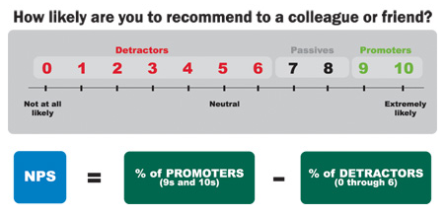
Net Promoter Score (NPS)

Slide 28
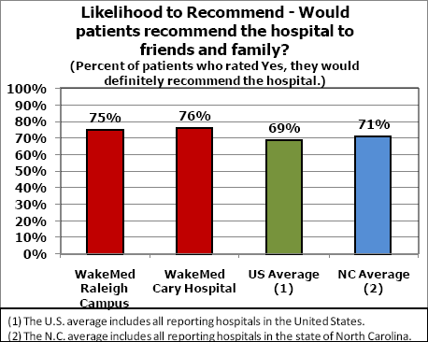
Likelihood to Recommend

Slide 29
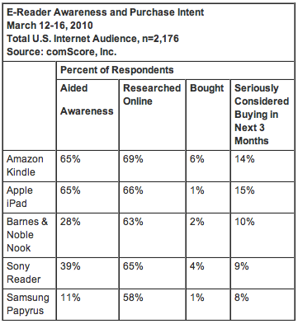
Intent to Purchase

Slide 30
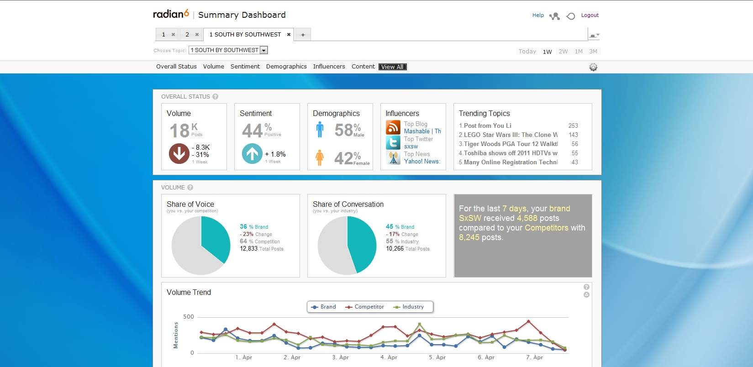
Share of Voice/ Share of Conversation

Slide 31
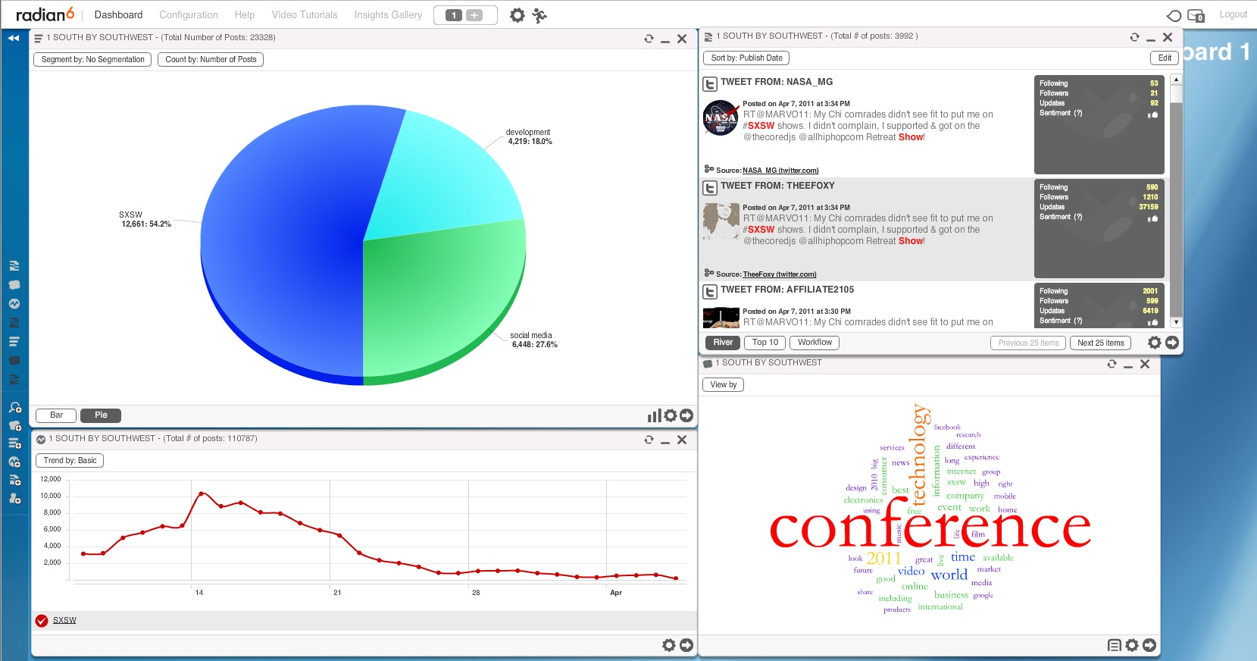
Themes/ Clusters

Slide 32
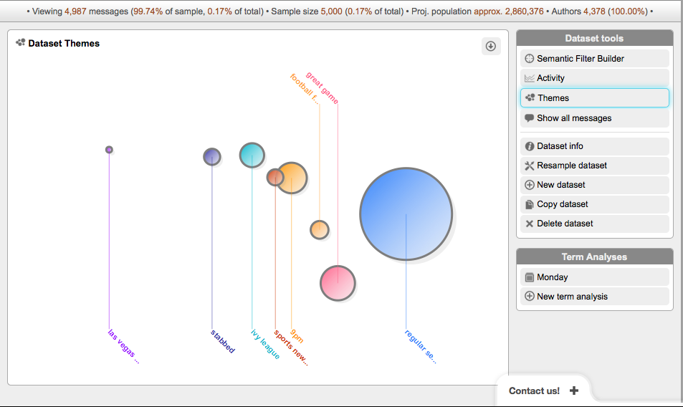
Themes/Clusters (CI)

Slide 33
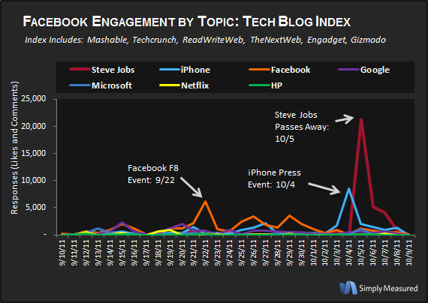
Buzz Timeline with Annotations

Slide 34
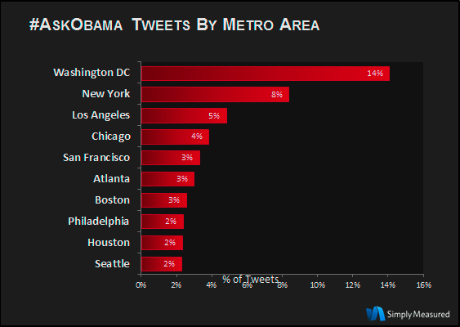
Audience Analytics

Slide 35
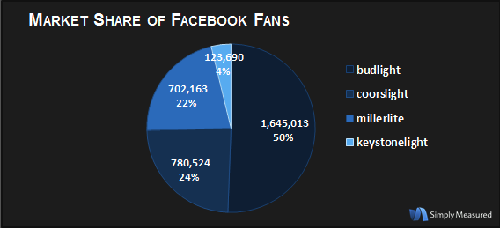
Market Share

Slide 36
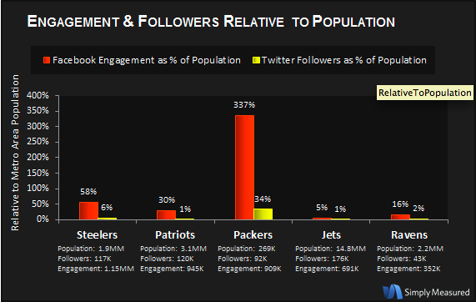
Audience Analytics

Slide 37
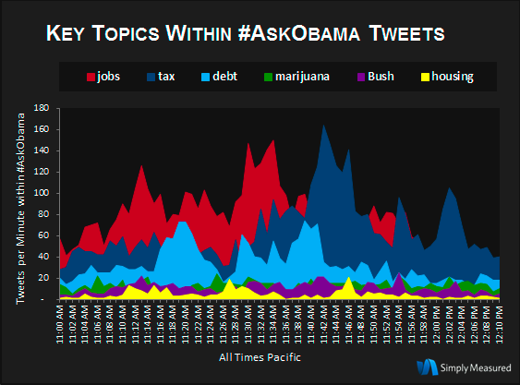
Themes/ Clusters

Slide 38
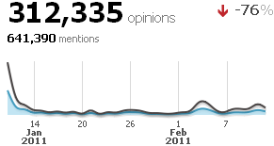
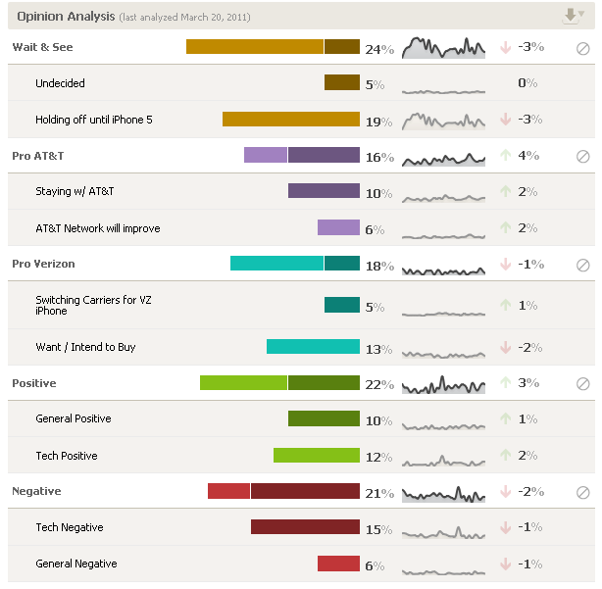
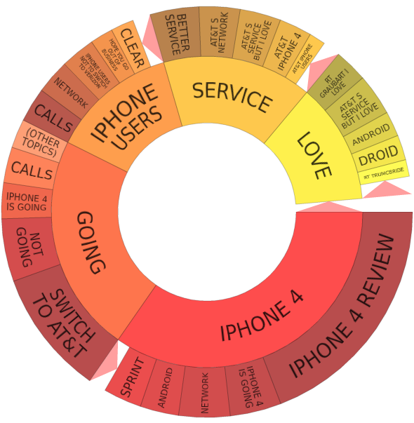
Crimson Hexagon for Social Analytics
iPhone on Verizon: Key Themes
Crimson Hexagon’s proprietary algorithm separates relevant from irrelevant content and measures user-defined themes in online conversation.

Slide 39
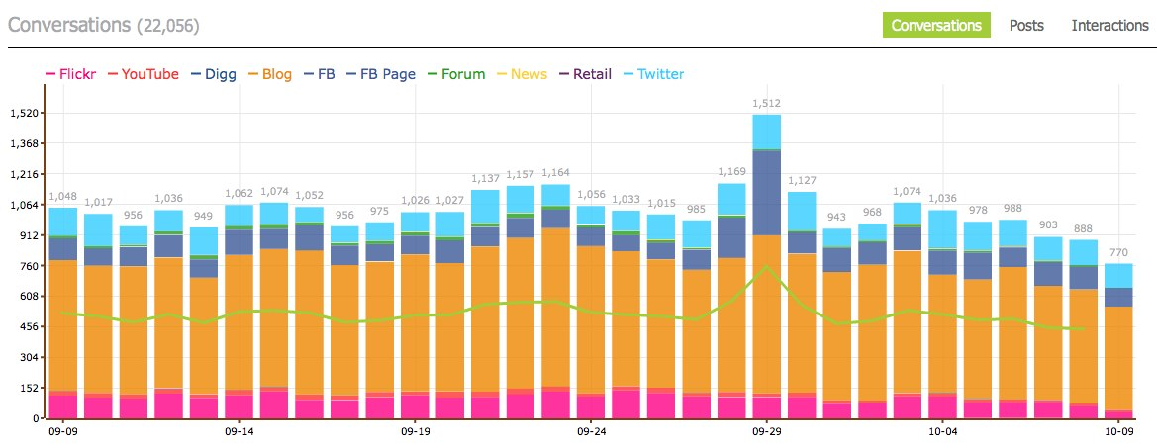
Tracx Social Analytics
Tracx offers white labeled social media monitoring platform.
Shows contextually weighted hits across many social mediums.
Can be tweaked to remove internal (employee) influencers in order to show more accurate campaign results.

Slide 40
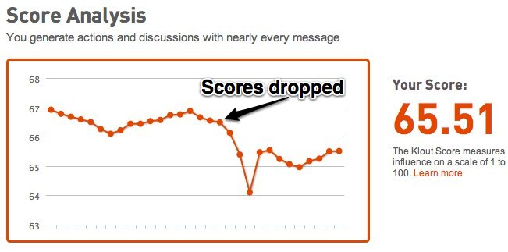
Gauging Influencers
Near the end of September Klout scores dropped by approximately 4 points across the board – with no explanation.
Tools that gauge influencers should not be trusted until these algorithms stabilize.

Slide 41
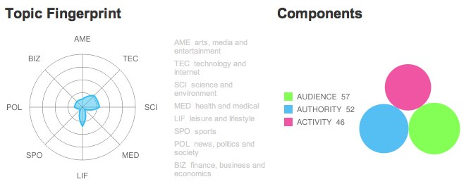
But if you must…
Peer Index is a decent alternative whose numbers don’t wildly fluctuate.

Slide 42
Marketing Optimization
Improving the effectiveness of marketing programs

Slide 44
Marketing Optimization
Metric:
Conversion Efficiency: Which visits convert most often?
% of Visitors

Slide 45
Marketing Optimization Scorecard
METRIC | PURPOSE | OLD MEDIA METRIC/ DATA SOURCE | NEW MEDIA METRICS | NEW MEDIA DATA SOURCE
LEADS, CONVERSIONS, REVENUE BY CHANNEL | Which channels are most effective for driving business results? | Analysis of sales by channel with attribution | Same | CRM System (assuming sales have a source)
OWNED MEDiA CHANNEL GROWTH | Are we growing our house marketing list/ assets? | Customer list (email, direct mail) | Followers, Fans, Friends, Group Members
IMPRESSIONS | How many impressions of our messages are being served? | Syndicated Research, Ad Servers | AVE (we hate this metric), Followers, Fans, Members | SMM tools, Wordle
FREQUENCY | How many times are people seeing our media? | Syndicated Research, Ad Servers | n/a | SMM tools
REACH | Are the people seeing our media the ones we’re trying to reach? | Customer database | Followers, Fans, Members | Facebook, Customer Database, Twitter
ENGAGEMENTS | Do consumers interact with the content we create for new media channels? | N/A | Clicks, Apps, Likes, Downloads, Fans, Faves, Retweets, Comments, Views, Followers | Social Media platforms, SMM tools, custom analysis
Notes:
Time on Site

Slide 46
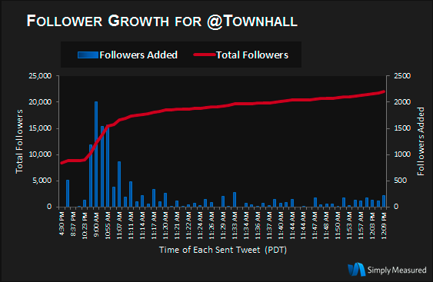
Owned Media Channels Growth

Slide 47
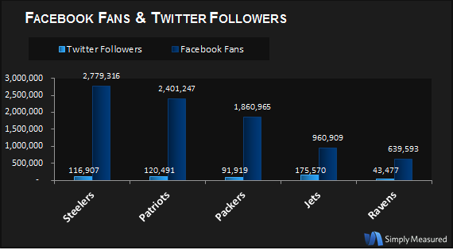
Owned Media Channels Vs Competitors

Slide 48
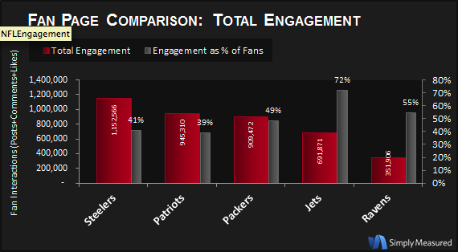
Engagement- Football

Slide 49
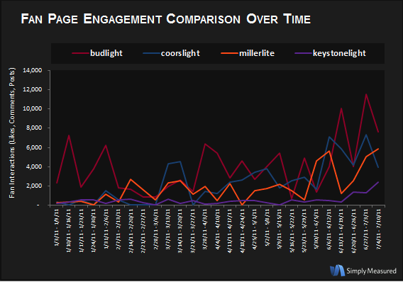
Engagement Over Time

Slide 50
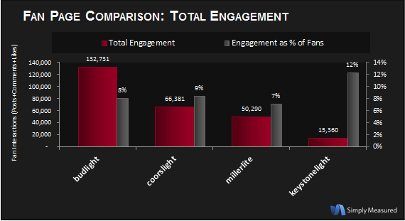
Engagement- Beer

Slide 51
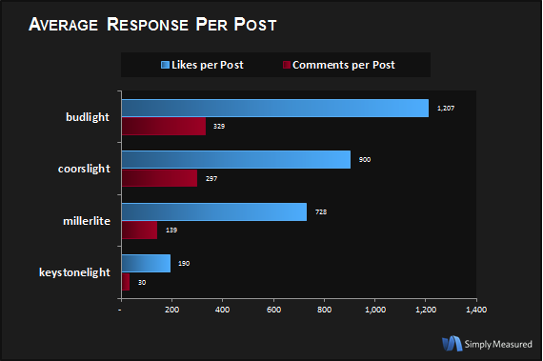
Engagement- Likes

Slide 52
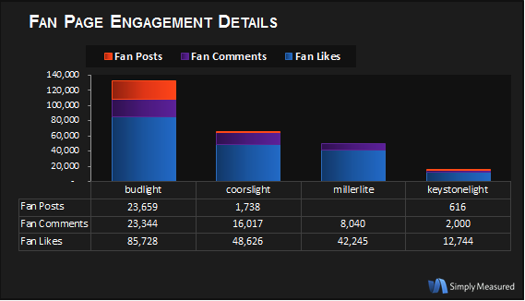
Engagement- Posts, Comments, Likes

Slide 53
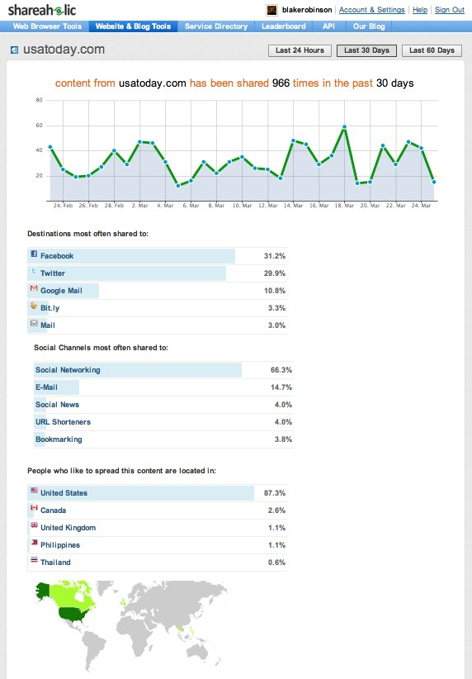
Shareaholic - http://www.shareaholic.com/siteinfo/usatoday.com
View the sharing stats of any sites shared through the Shareaholic browser extension
Pages are accessible at http://www.shareaholic.com/siteinfo/sitename.com

Slide 54
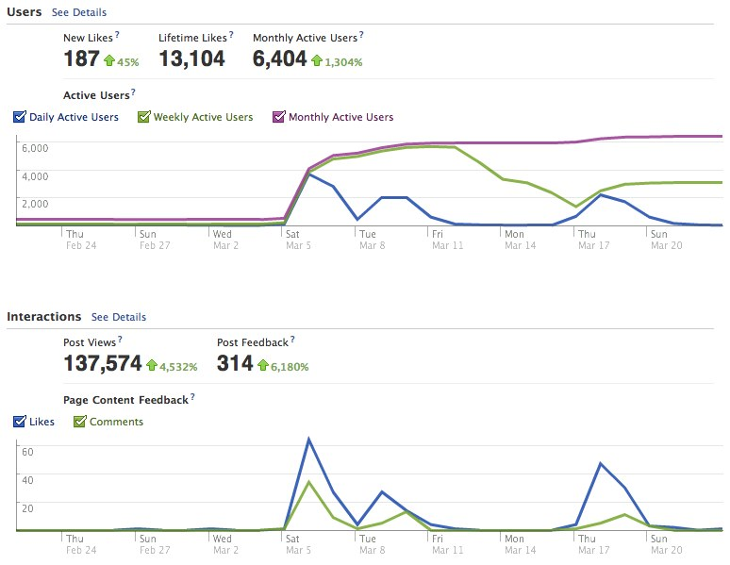
Facebook Insights
Facebook Insights provides a top down perspective on who comprises your audience and what they do on your Facebook Page.

Slide 55
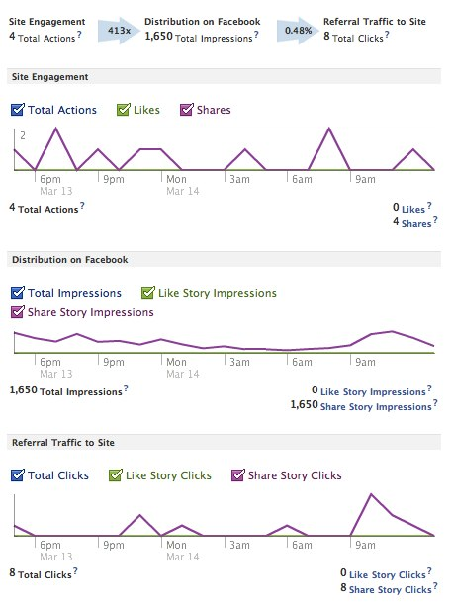
Facebook Insights for Websites
You can include a tag on your site which will allow you to measure the impact that Facebook Likes/ Share have on you site traffic.
Excellent supplement to Google Analytics (even with the recent introduction of real time analytics).

Slide 56

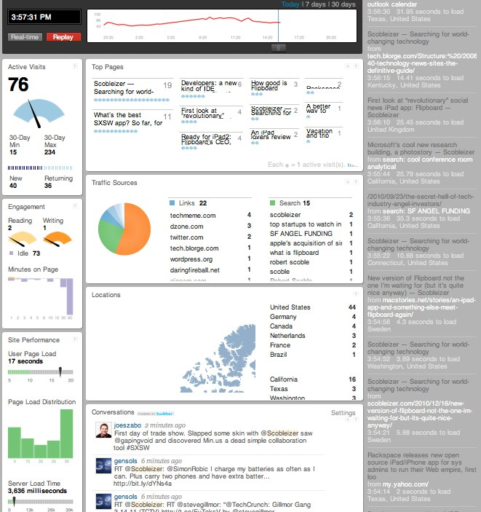
Simple Server Side Analytics Via Tagging
Chartbeat provides an excellent way to visualize the correlations between content publishing and real time site traffic.
Simple for marketers to use: put a (really light) tag on your site and Chartbeat’s server side analytics will analyze the data for you.

Slide 57

Simple Server Side Analytics Via Tagging
In addition to its standard Chartbeat product, two specialized analytics platforms are now offered.
Newsbeat is focused aimed at content creators, bloggers, etc.
Shopbeat is designed specifically for ecommerce sites.

Slide 58
Revenue Generation
Where and how your company or organization generates revenue

Slide 60
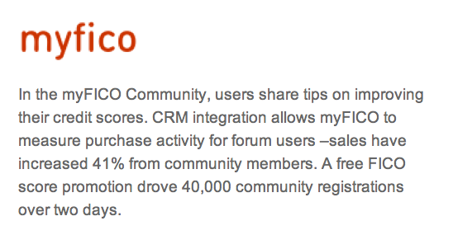
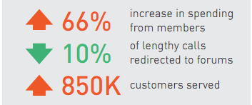
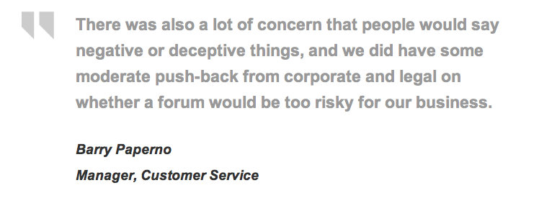
Revenue Generation
Metric:
Increase in member spending
Source: http://www.lithium.com/pdfs/casestudies/Lithium-FICO-Case-Study.pdf Disclosure: Lithium is a client of Altimeter.

Slide 61
Revenue Generation Scorecard
METRIC | PURPOSE | OLD MEDIA METRIC/ DATA SOURCE | NEW MEDIA METRICS | NEW MEDIA DATA SOURCE
LEADS, CONVERSIONS, REVENUE BY CHANNEL | Which channels are most effective for driving sales? | Analysis of sales by channel with attribution | Same | CRM System (assuming sales have a source)
SEARCH | What kinds of content are most cost effective in raising organic search rankings? | Page Rank | Same | Search Engines; HubSpot
TRANSACTION SIZE | How much does the average customer spend? | AOV | Same | CRM/ Internal Systems
TRANSACTION FREQUENCY | How often does the average customer buy? | Recency/ Frequency | Same | CRM/ Internal Systems
SALES INFLUENCED | Were the customers who bought influenced by our media? | Source of Sales/ How did you hear of us? | Same | CRM/ Internal Systems/ Survey
REVENUE BY RATINGS/REVIEWS | Does consumer generated content help prospect make purchase decisions? | N/A | Revenue by Ratings/ Reviews | Web Analytics Platform; Rating Platform
Notes:
Susan Petco Example

Slide 62
Keys to Revenue Attribution
Source attribution in the CRM system
Source interaction in the CRM system
  Social media identity appended to the database

Slide 63
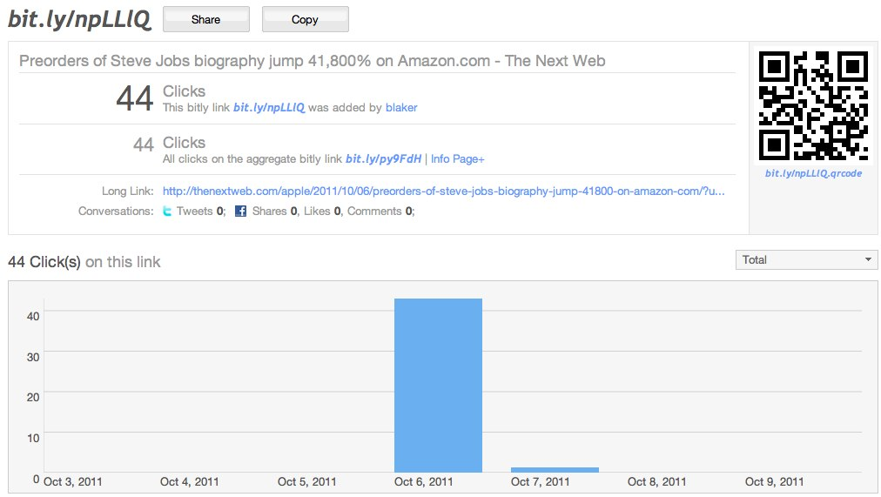
Bitly
Bit.ly provides analytics behind each link and breaks down the number of clicks and other truncated links to the same site, as well as referral and geographical data.

Slide 64
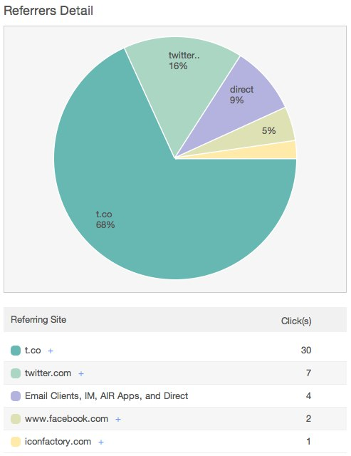
Bitly
Bit.ly, and other URL truncation services, also provide a layer of analytics that can extend your tracking capabilities to any destination that allows clickable links.
This allows you to track referrals through walled services like Facebook and LinkedIn.

Slide 65
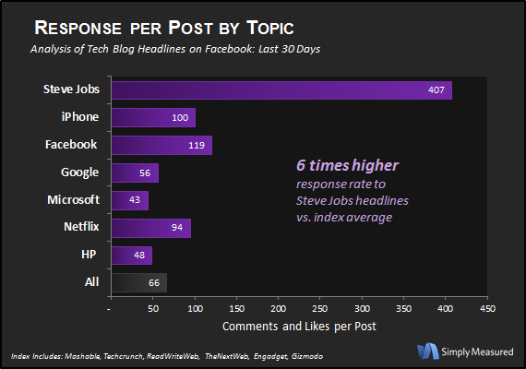
ROI: Page Views Vs. Sales

Slide 66
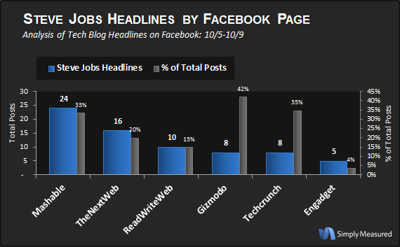
Content Performance

Slide 67
Customer Experience
Improving your relationship with customers and their experience with your brand

Slide 69
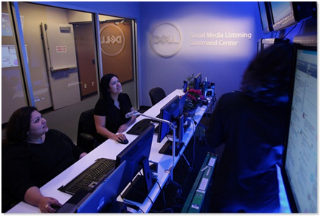
Customer Experience
Metric:
Social Service Levels
(in development)
Dell’s Social Media Listening Command Center (Courtesy Dell, Inc.)

Slide 70
Customer Experience Scorecard
METRIC | PURPOSE | OLD MEDIA METRIC/ DATA SOURCE | NEW MEDIA METRICS | NEW MEDIA DATA SOURCE
ATTITUDES | How people talk about your brand & product | Market Research | Customer quotes/ insights | SMM tools
ISSUES AND CRISES | Service & product issues, emerging crises | Market Research | Theme/Cluster Analysis | SMM tools, Wordle
INTENSITY | Momentum of a topic or issue | Market Research | Buzz | SMM tools
BLIND SPOTS | “What are we missing” in relation to NPS or customer satisfaction scores | Market Research | Customer Quotes/ Insights | SMM tools
SERVICE LEVELS | Performance of social CRM |  | # of service issues | SMM tools, annotation
CONTEXT | Are they having the right impact? | Market Research | Most common keywords | SMM tools, custom analysis

Slide 71
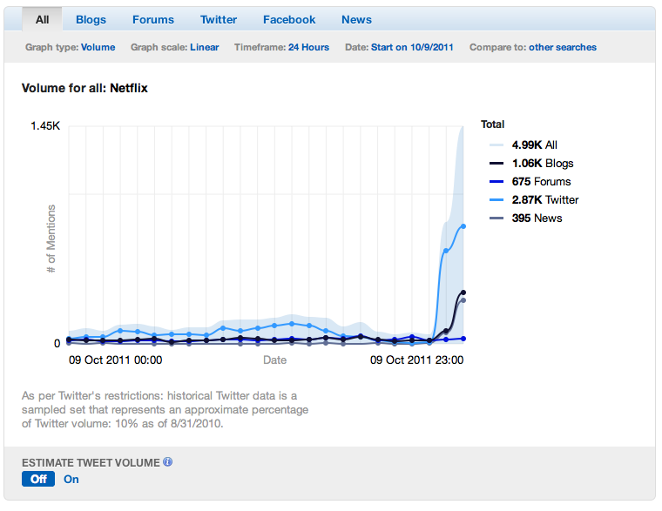
Buzz on NetFlix/Qwikster

Slide 72
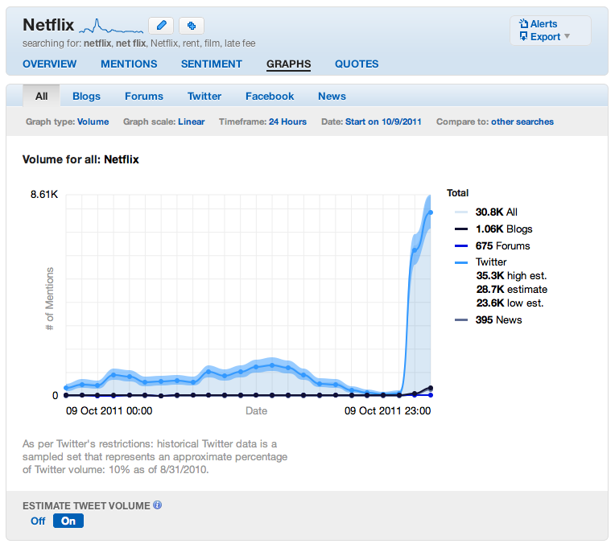
Buzz on NetFlix/Qwikster

Slide 73
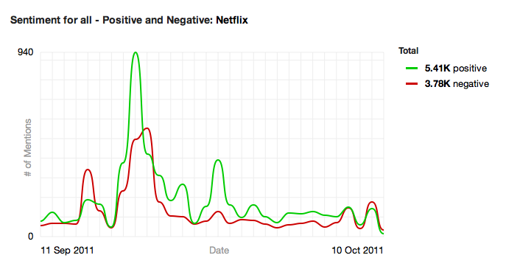
Sentiment for Netflix

Slide 74
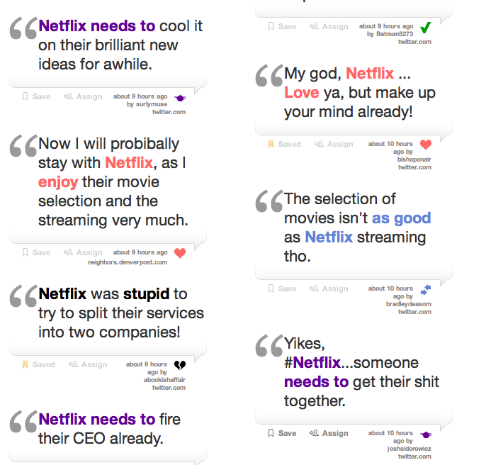
Qualitative Consumer Opinion on NetFlix

Slide 75
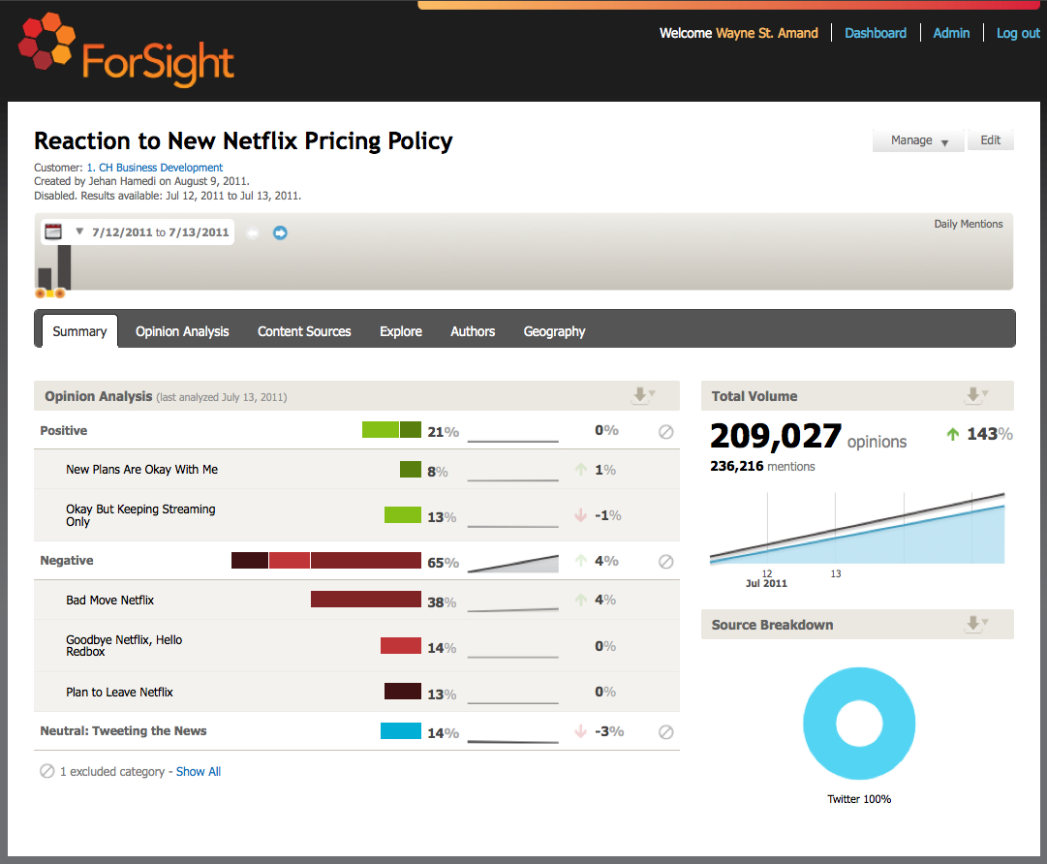
Notes:
Here’s a look at nearly 210,000 consumer opinions from Twitter related to Netflix and its recently announced change in its pricing plans. It’s not surprising that 65% tweeting about Netflix reacted negatively to the change. What is surprising is that 14% of customers expressed the following opinion: “Goodbye Netflix, Hello Redbox”. If you were Redbox, what would you do with this information? How about Hulu? Could this change your plans if you’re Hulu?

Slide 76
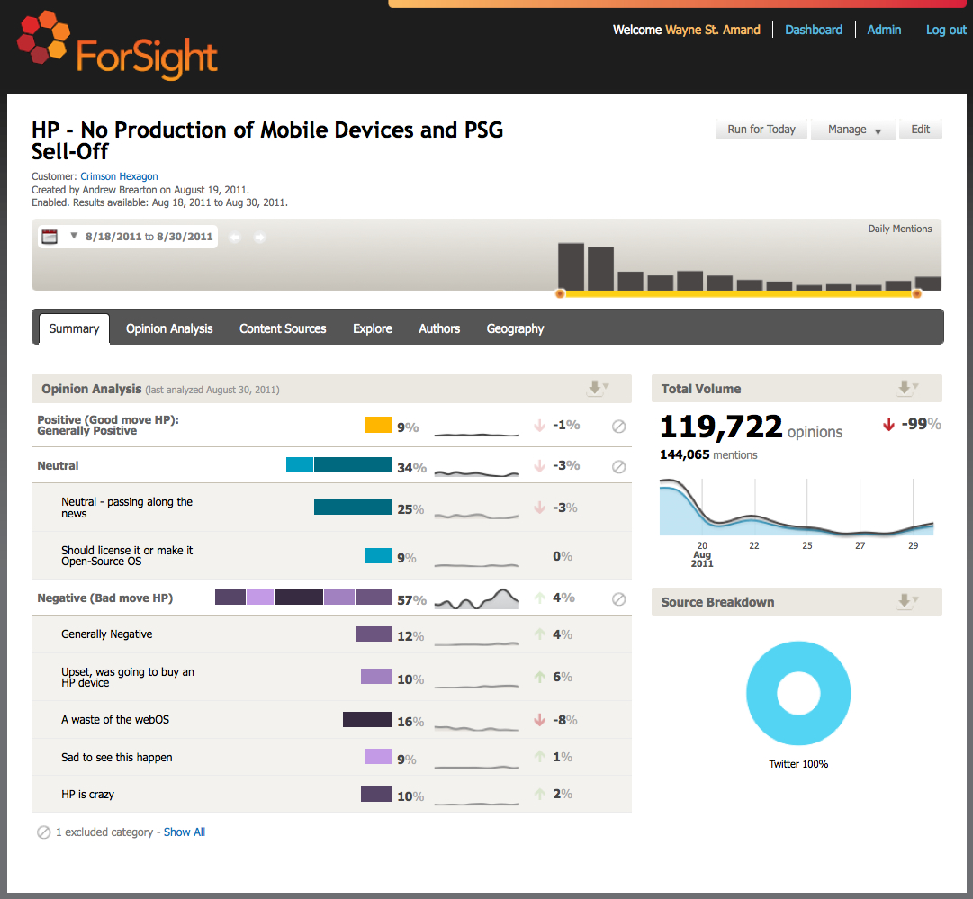
Notes:
Crimson Hexagon, founded in 2007, is the leading provider of real-time social media monitoring and analysis to brands, agencies, media firms and their partners. Powered by patent-pending technology developed at Harvard University’s Institute for Quantitative Social Science, the Crimson Hexagon ForSight™ platform overcomes the limits of traditional market research by delivering a real-time view of how engaged online consumers truly think and feel about a brand or issue.
You may remember that HP recently announced the end of its WebOS tablet as well as its desire to divest itself of the PC hardware business. We analyzed about 120,000 online opinions (all from Twitter) related to HP’s news. We found nearly 60% of online consumers disagree with this move and feel that HP is making a mistake. 10% even stated they had intended to buy an HP device. If you were Leo Apotheker (HP’s then CEO) wouldn’t you like to understand this real-time consumer opinion about your business strategy?

Slide 77
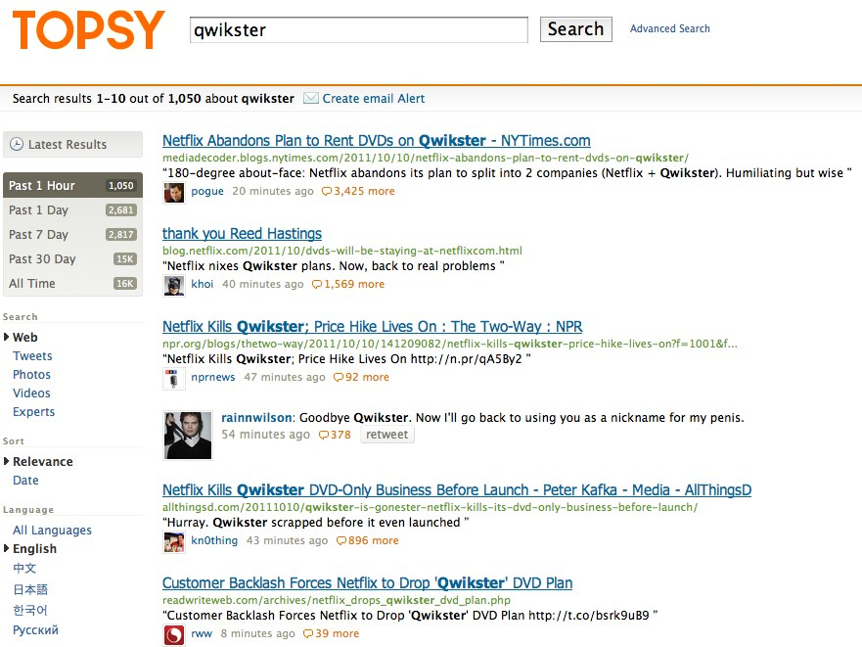
TOPSY
Forget search.twitter.com
Topsy is better on all counts.
Functional breakouts by time, content, influence, etc.

Slide 78
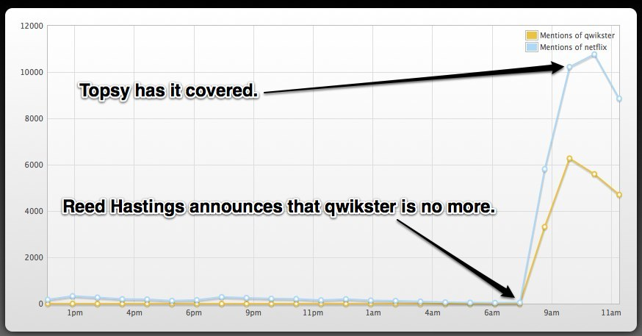
TOPSY Labs
Topsy provides analytics behind your searches.
Topsy is better than Twitter’s own search on all counts.
It’s free!

Slide 79
Operational Efficiency
Where and how your company or organization reduces expenses

Slide 81

Operational Efficiency
Metric:
Percentage of inquiries resolved in social channels

Slide 82
Operational Efficiency Scorecard
METRIC | PURPOSE | OLD MEDIA METRIC/ DATA SOURCE | NEW MEDIA METRICS | NEW MEDIA DATA SOURCE
CUSTOMER SERVICE ISSUE RESOLUTION | Keeping track of the number, severity, and cost of service issues | Number and cost of issues resolution by channel | Same | New engagement platforms, SMM tools
CUSTOMER SERVICE ISSUE REDUCTION | Becoming more effective at heading off customer service issues | Call deflection, issue resolution | Same | New engagement platforms, SMM tools, internal analysis
ADVOCATE NETWORK GROWTH | Crowdsourcing of content creation and peer support network | WOM | # & % of issues resolved by crowdsourced resources | Community platform, web analytics, internal analysis
CUSTOMER SATISFACTION BY RESOLUTION CHANNEL | Customer satisfaction with corporate response to service issue | Customer Satisfaction | Same | Survey data, SMM tools

Slide 83

Customer Response Dashboard

Slide 84

Response Rate

Slide 85

Response Time

Slide 86
Innovation
Collaborating with customers to drive future products and services

Slide 88

Innovation
Metric:
Ideas generated, productized per year

Slide 89
Brand Health Scorecard
METRIC | PURPOSE | OLD MEDIA DATA SOURCE | NEW MEDIA METRICS | NEW MEDIA DATA SOURCE
# of Ideas Generated | Getting new ideas from customers | Market Research | Count of Ideas, Crowdsourced Votes/ Likes on Ideas as Quality Metric | Idea platform/ Internal Analysis
# Ideas Productized | Turning customer ideas into product enhancements | % Product Enhancement from Customer Ideas | Same | Internal Analysis
Speed to Market | Speed of idea generation/ productization | Speed to Market | Same | Internal Analysis

Slide 90

SalesForce Idea Exchange

Slide 91

Ideas Implemented

Slide 92
Organizing for Social
Identify your organizational model for social media.
Based on that model, outline the roles and responsibilities of your measurement team, including:
    Resources
    Ownership
    Processes
    Training and education
    Collaboration

Slide 93
Organizing for Social
If you choose to outsource some or all social media monitoring:
    Balance domain expertise, analytical skill, and tool mastery
    Consider information sensitivity
    Plan for knowledge transfer
    Implement checks and balances
    Compare expenses

Slide 94
thank you
#socialmeasure #w2e
@margaretfrancis
@setlinger
@blake (and http://blakepl.us on G+)

